Slide 1

MIMIC Visualization
Ankita Savaliya
AI In Healthcare Course at UT Austin

Slide 2
Coding environment and packages
Google Colab
MIMIC-III Demo Dataset
Used Google Drive for saving and loading MIMIC CSV data
Libraries Used: matplotlib, seaborn, plotly, WordCloud, altair
GitHub and Google Colab Links:
https://github.com/AnkitaSavaliya/AIH/blob/main/MIMIC_Visualization.ipynb
https://colab.research.google.com/github/AnkitaSavaliya/AIH/blob/main/MIMIC_Visualization.ipynb
https://github.com/AnkitaSavaliya/AIH/blob/main/MIMIC%20Visualization.pptx

Slide 3
Data Load and Initial Setup
Used PATIENTS .CSV, ADMISSIONS.CSV , DIAGNOSES_ICD.CSV, D_ICD_DIAGNOSES.CSV, ICUSTAYS.CSV, PRESCRIPTIONS.CSV etc.
Created the initial dataframe using PATIENTS, ADMISSIONS, and DIAGNOSES_ICD.
Merged the dataframe with other CSV files as needed for visualization requirements.

Slide 4
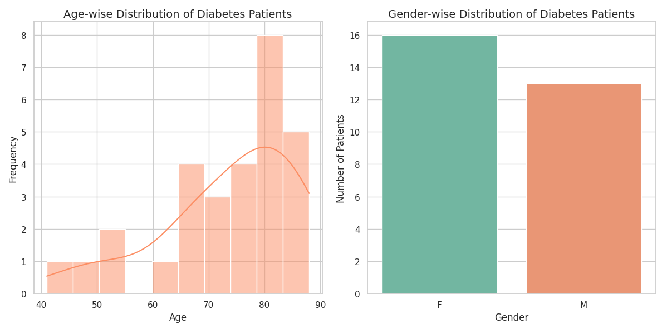
Visual 1- Age and Gender-wise Distribution of Diabetes Patients
This visualization represents diabetes patients, showcasing their age and gender distribution. It uses Seaborn to create a histogram for age-wise distribution and a barplot for gender-wise distribution.

Slide 5
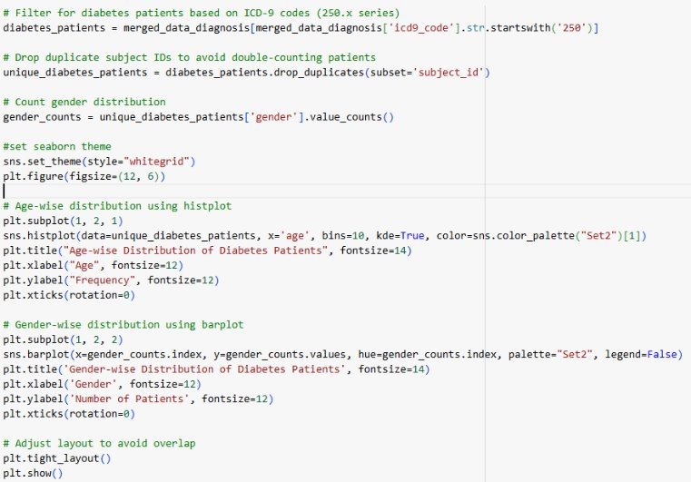
Visual 1 - How to recreate
Filters patient records based on ICD-9 codes (250.x series)
Eliminates duplicate patients by their unique IDs.
Counts gender distribution among unique patients.
Plot histogram and barchart

Slide 6
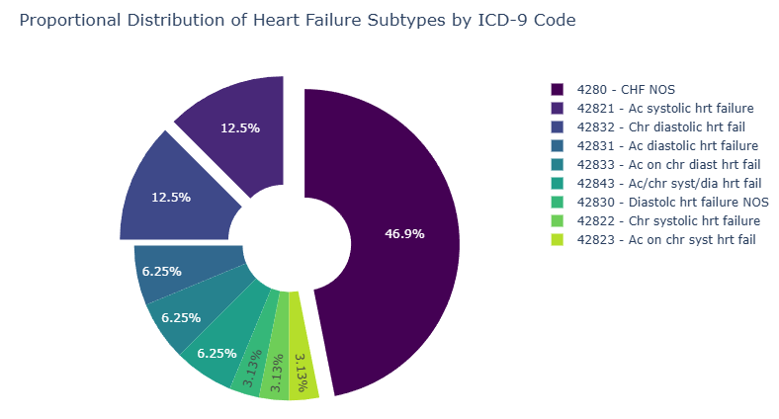
Visual 2- Proportional Distribution of Heart Failure Subtypes by ICD-9 Code
This visualization is an interactive pie chart displaying the proportional distribution of heart failure subtypes.

Slide 7
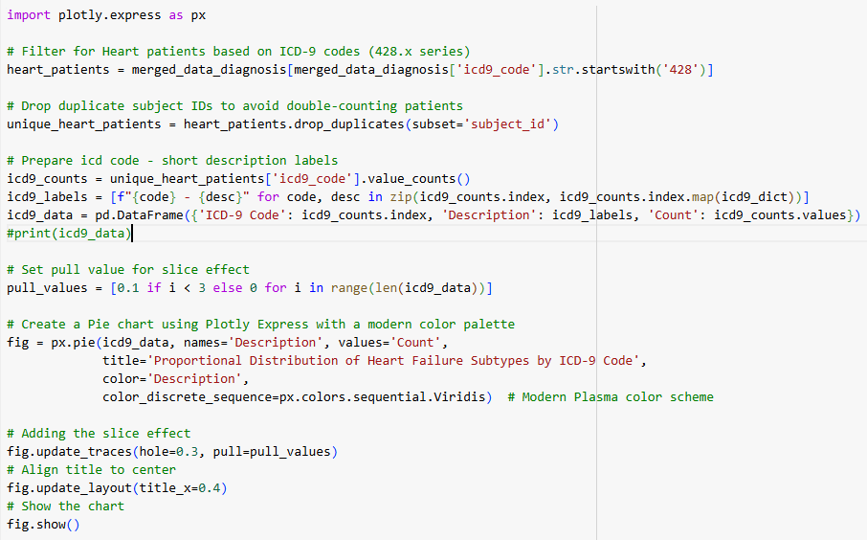
Visual 2 - How to recreate
Extracts patient records with ICD-9 codes (428.x series for heart failure).
Counts occurrences of each ICD-9 code and prepares labels.
Creates an interactive pie chart using Plotly Express.

Slide 8
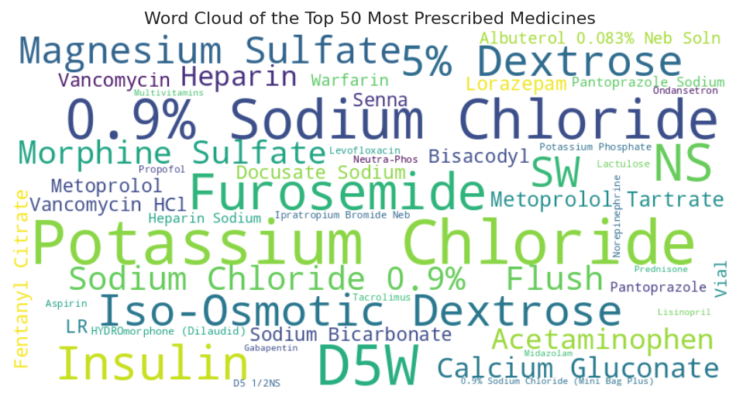
Visual 3 - Word Cloud of the Top 50 Most Prescribed Medicines
This visualization is a word cloud showcasing the top 50 most prescribed medications.

Slide 9
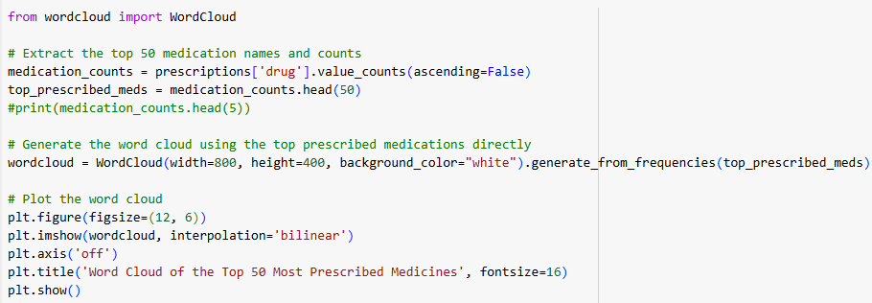
Visual 3 - How to recreate
Extracts the top 50 most prescribed medication names and their counts from the dataset.
Creates and display a word cloud using the frequency of these medications, with larger font sizes representing higher prescription counts.

Slide 10
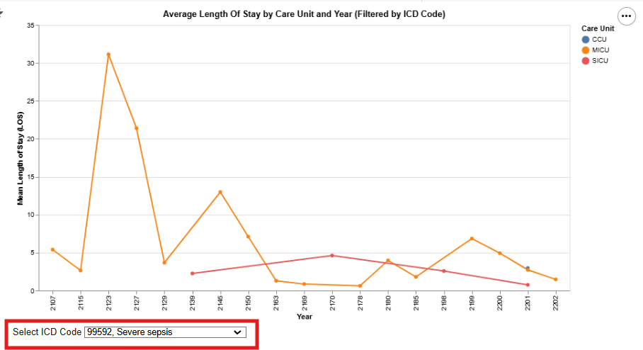
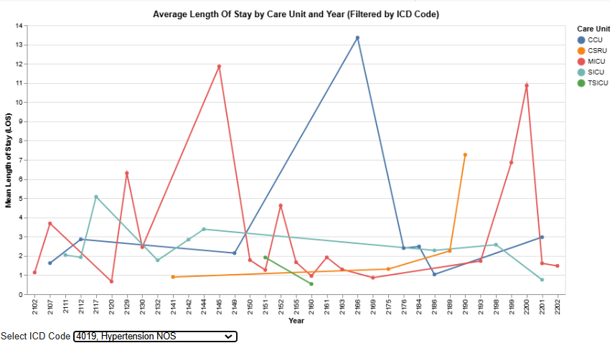
Visual 4 - Average Length Of Stay by Care Unit and Year (Filtered by ICD Code)
This visualization is an interactive line chart created with Altair, analyzing the average length of stay (LOS) by care unit and year, dynamically filtered by ICD-9 codes.

Slide 11
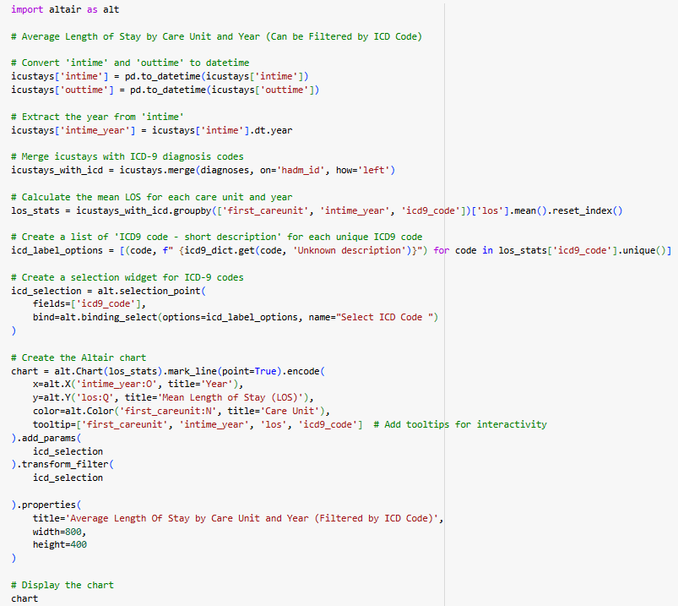
Visual 4 - How to recreate
Converts ICU stay times to datetime format and extracts the year and merges ICU stay data with ICD-9 diagnosis codes.
Calculates the mean LOS for each care unit and year.
Creates and display a line chart showing trends in LOS by care unit and year with selection box for ICD-9 code.

Slide 12
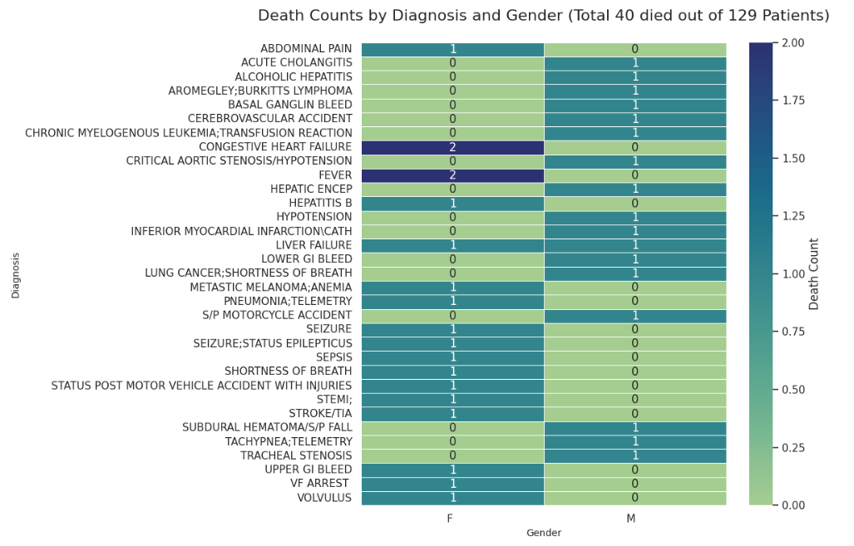
Visual 5 - Analysis of Death Counts by Diagnosis and Gender
This visualization represents deceased patients categorized by their diagnosis and gender.

Slide 13
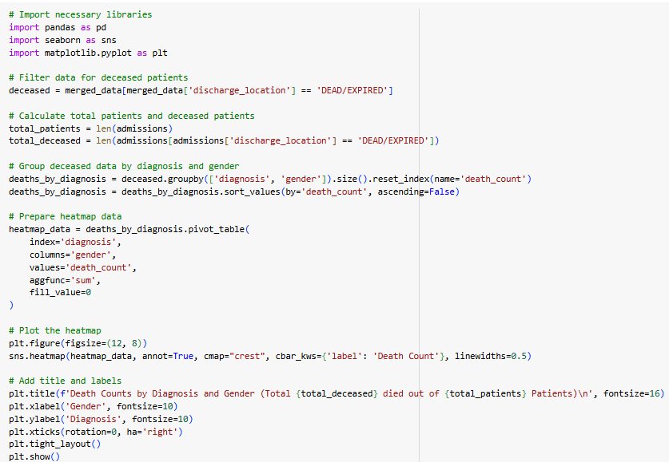
Visual 5 - How to recreate
Filter the data for deceased patients.
Aggregate the death counts by diagnosis and gender.
Create and plot a heatmap to visually compare death counts across diagnoses and genders.

Slide 14
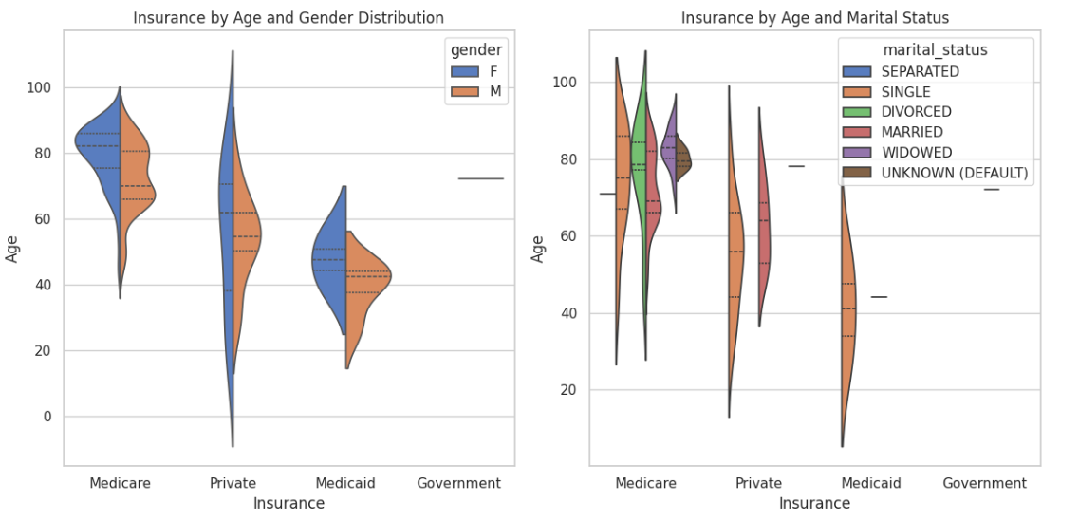
Visual 6 - Insurance Analysis based on Gender and Marital Status
This visualization represents the distribution of age across insurance types, segmented by gender and marital status. It uses Seaborn's violin plots for detailed representation of the data.

Slide 15
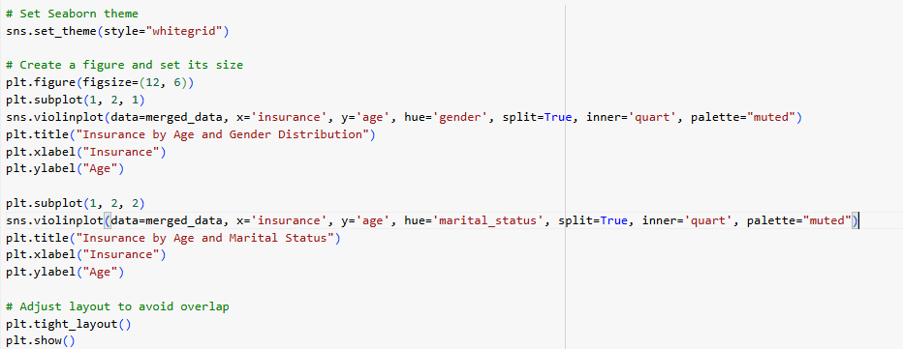
Visual 6 - How to build/recreate
Create and display violinplot showing age distribution by insurance type, split by gender.
Create and display violinplot showing age distribution by insurance type, split by marital status

